Slide 1
Statistics
367-1-4361
Probabilities
Opher Donchin

Slide 2
Course goals
Understand what data is
Create models that may explain data
Draw conclusions about the models from the data
Test hypotheses by comparing models

Slide 3
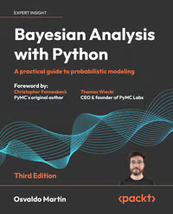
Bayesian Analysis with Python
3rd edition!!
GitHub
Publisher’s website
Full text available
  the library
Easy to read!

Slide 4
Grading
Pre-lecture questions
  Questions are worth 5% of the grade
Exercises
  Exercises are worth15% of the grade
  5 exercises. Each worth 3.6%
Midterm quiz
  10% of the grade. Can only improve grade!
  On computers during recitation section on 17-18/6
  Practice for exam
Exam
  70% of the grade
  On computers on campus
  Open book (material on Moodle only!)
  2 hours
  Students who do not pass the exam will not pass the course

Slide 5
1A What is data

Slide 6
What is statistics
Its two main goals
Data
Collecting
Organizing
Analyzing
Interpreting
Exploratory data analysis
Inference
Data
Data
Data

Slide 7

From Truth to Data
Francis Bacon
  Novum Organum 1620
  Facts and observations give us evidence
Pierre-Simon Laplace
  Theorie analytique des probabilities 1812
  Observations are givens, but they are uncertain
Carl Friedrich Gauss
  Theoria motor corporum coelestium 1809
  Process givens to improve estimates
  In Latin: givens is data

Slide 8
Data gives birth to statistics
Adolphe Quetelet
  Sur l’homme 1835
  Data on heights implies an “average man”
Francis Galton
  Hereditary Genius 1869
  Multi-variate data
  Variability and co-variance
Karl Pearson
  The Grammar of Science 1892
  Using data to establish scientific truth
Ronald Fisher
  The Design of Experiments 1935
  Data is not given; it is generated by design

Slide 9
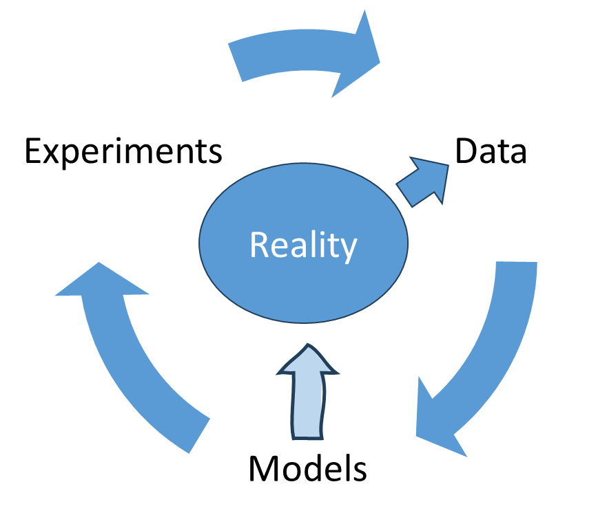
Reality, Data, and Models
Experiments produce data from reality
Data updates models of reality
Models lead to further experiments

Slide 10
Reality, Data, and Models
Experiments
Data
Reality
Models

Slide 11
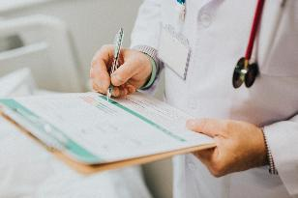
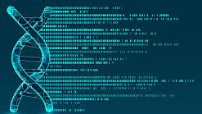
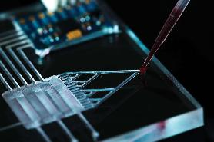
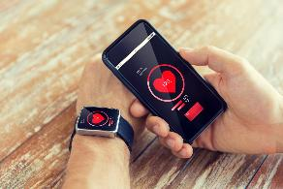
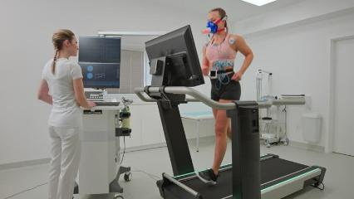
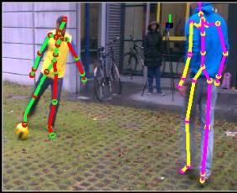
Sources of data in biomedical engineering
Genomic data
Biological data
Physiological data
Clinical data
Models and simulations
New sources:
  Large datasets
  Wearable technology
  Image and video processing

Slide 12
Uses of data in biomedical engineering
Basic science
Clinical testing
Clinical trials
Calibrating models
Product development

Slide 13
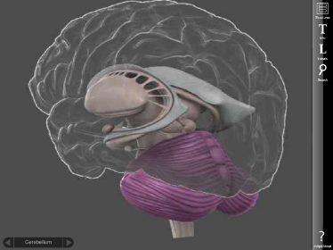
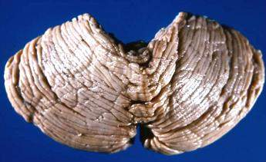
An example
Cerebellar volume
http://de.wikibooks.org/wiki/Neuroanatomie:_Kleinhirn
http://brainposts.blogspot.co.il/2011/11/neuropsychology-and-cerebellum-part-i.html

Slide 14
What is data
An ordered set of ‘observations’ or ‘measurements’
  Each observation could be vector valued
  Data is finite!

Slide 15
What is data
An ordered set of ‘observations’ or ‘measurements’
  Each observation could be vector valued
  Data is finite!
Analyze the brain scans of 5 individuals and extract the size of each cerebellum
We have to choose the right thing to measure
Cerebellar volume in liters:
0.16 0.15 0.18 0.21 0.16
Cerebellar volume in fraction of total intracranial volume (TICV):
0.13 0.13 0.12 0.13 0.13

Slide 16
What is data
An ordered set of ‘observations’ or ‘measurements’
  Each observation could be vector valued
  Data is finite!
Analyze brain scans of 60 subjects and extract cerebellar volumes
We can get more data, but it will still be data
Cerebellar volume in fraction TICV for 60 subjects:
0.13 0.13 0.12 0.13 0.13 0.13 0.14 0.10 0.12 0.13
0.11 0.15 0.14 0.14 0.11 0.14 0.14 0.14 0.13 0.14
0.12 0.10 0.11 0.12 0.15 0.14 0.13 0.14 0.14 0.12
0.13 0.15 0.14 0.13 0.13 0.13 0.14 0.13 0.13 0.15
0.12 0.13 0.11 0.10 0.14 0.12 0.15 0.13 0.13 0.13
0.11 0.14 0.14 0.12 0.14 0.13 0.14 0.11 0.12 0.14

Slide 17
1B What is good data

Slide 18
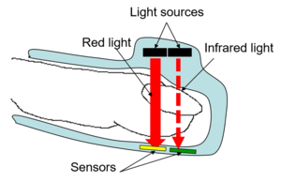
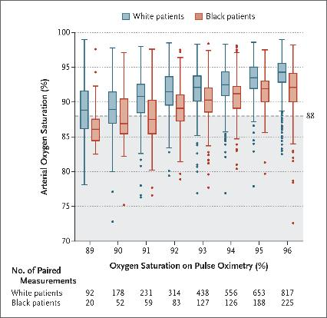
Imperfect data
Data is never perfect
  Sampling bias
    Pulse oximeters tested on white skin
    Poorly calibrated for darker skin
    During Covid-19, black patients had:
      Lower detection
      Delays in treatment
N Engl J Med 2020;383:2477-2478
DOI: 10.1056/NEJMc2029240

Slide 19
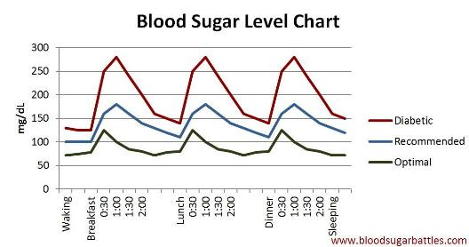
Imperfect data
Data is never perfect
  Sampling bias
  Measurement error
    Inaccurate glucose monitors (2018)
    Over and underdosing insulin
Diabetes Care 1 August 2018; 41 (8): 1681–1688. https://doi.org/10.2337/dc17-1960

Slide 20
Imperfect data
Data is never perfect
  Sampling bias
  Measurement error
  Missing data
    Increases variance
    May introduce bias
N Engl J Med 2020;383:2477-2478
DOI: 10.1056/NEJMc2029240

Slide 21
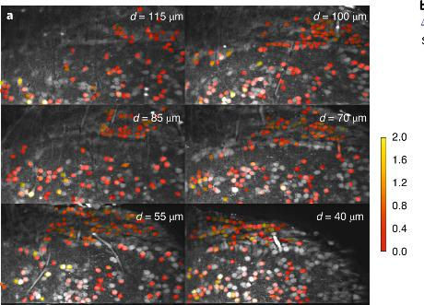
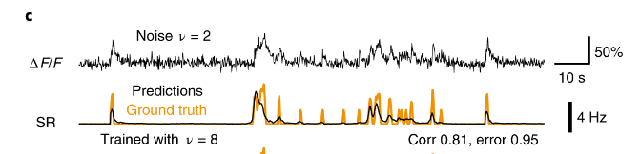
Imperfect data
Data is never perfect
  Sampling bias
  Measurement error
  Missing data
  Proxy measures
    Intracellular calcium
      Used for neural activity
    Proxies are:
      Nonlinear
      Incomplete
      Context-dependent
Nat Neurosci 24, 1324–1337 (2021). https://doi.org/10.1038/s41593-021-00895-5

Slide 22
Key issues in measurement
What are you measuring?
What is its precision?
Is it valid?
Is it reliable?

Slide 23
Precision
What is a reasonable precision?
How much precision do you need to draw conclusions?
Some things are imprecise by nature
  Quality of life
  Preference
  Fitness

Slide 24
Validity
Does the measure measure what you want?
  A written test cannot measure musical ability
Do we have a gold standard?
Can we poll experts?

Slide 25
Reliability
A measure that is precise and stable
The value will stay the same if:
  We measure again
  Someone else measures
  We measure at a different time

Slide 26
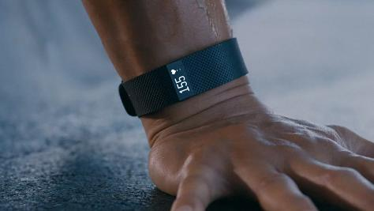
Data Ethics
As data becomes increasingly important
  We become increasingly responsible
Privacy
Security
Ethical use
  Wearable devices share health information with companies
  Can those companies share that information?
The Information Society, 34(1), 49–57. https://doi.org/10.1080/01972243.2017.1391912

Slide 27
Strategies for ethical data use
Informed consent
  Explain how and why it is being collected
  Allow participants to opt out
Transparency
  Who has access and how will it be used
Protect vulnerable populations
  Data should not lead to discrimination
  Data collection should not lead to secondary harm

Slide 28
1C Types of data

Slide 29
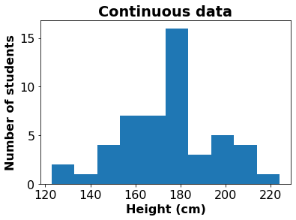
Continuous data
The data are real numbers
  Between any two data values there could be another data point
Examples:
  Rate, size, amplitude, time

Slide 30
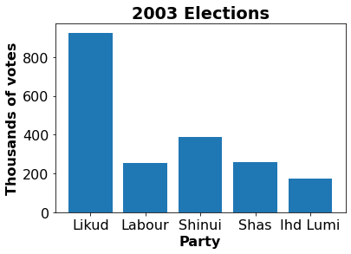
Categorical data
Values can’t really be compared or put on a scale
Examples:
  Gender (male / female)
  Race
  Personality type
  Color

Slide 31
Ordinal data
Something between continuous and categorical
Data can be ordered but are not real numbers
Data maps onto the integers
Examples:
  Child, teen, adult
  Strongly approve, approve, don’t care, disapprove, strongly disapprove
  Undergraduate student, graduate student, lecturer, professor

Slide 32


Combining different data types
A datum could have multiple parts:
  From a database of brain scans:
    Gender
      Categorical
    Handedness
      Categorical
    Age
      Ordinal / continuous
    Education
      Ordinal
    Total intracranial volume
      Continuous (ordinal)
    Normalized brain volume
      Continuous
  Taken together, all of these would be one data point
Female
Right handed
74 years
High school
1344 mm³
0.743
Male
Right handed
39 years
College
1636
0.739

Slide 33
1D What is probability

Slide 34
A basic approach
Start with data
Make model of data
Combine data with model
  To reach conclusions
Evaluate model
  Update
Repeat

Slide 35
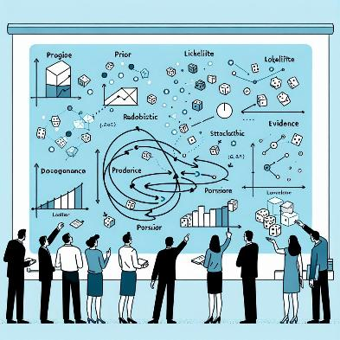
To get this basic approach to work
Data is imperfect
Our model will treat it as stochastic
So:
  We need to review probability

Slide 36
Definition of Probability (from Measure theory)
Experiment: toss a coin twice
Sample space: possible outcomes of an experiment
  S = {HH, HT, TH, TT}
Event: a subset of possible outcomes
  A={HH}, B={HT, TH}
Probability of an event : an number assigned to an event Pr(A)
  Axiom 1: Pr(A) ≥ 0
  Axiom 2: Pr(S) = 1
  Axiom 3: For every sequence of disjoint events

Slide 37
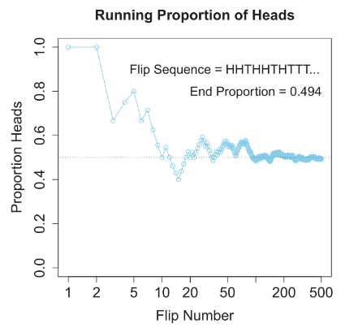
What does P(A) mean?
Frequentist interpretation (Out of the head)
  If we repeat the experiment N times, the number of times A occurs (#A) converges to:

Slide 38
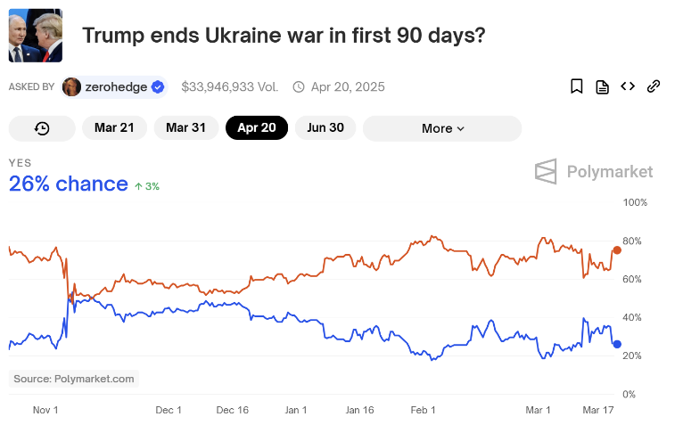
Example: political futures
https://polymarket.com/event/trump-wins-ends-ukraine-war-in-90-days?tid=1742336531501

Slide 39
What does P(A) mean?
Frequentist interpretation (Out of the head)
Plausibility (In the head)
  How likely is it that the coin is fair?
  Calibrate by choosing a bet
    Political futures markets

Slide 40
What does P(A) mean?
Frequentist interpretation (Out of the head)
Plausibility (In the head)
  How likely is it that the coin is fair?
  Calibrate by choosing a bet
    Political futures markets
  Or by assigning a distribution

Slide 41

de Finetti’s Dutch Book (1975)
A Dutch book is a book of bets that lets you beat the house at gambling
de Finetti derives axioms of probability from assumption that we assign probability such that a Dutch book is impossible
This is the idea followed by Kruschke

Slide 42
1E Random variables

Slide 43
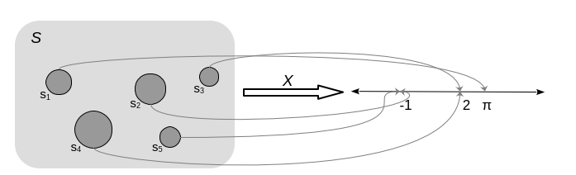
Random variables
A mapping from subsets of all possibilities to values

Slide 44
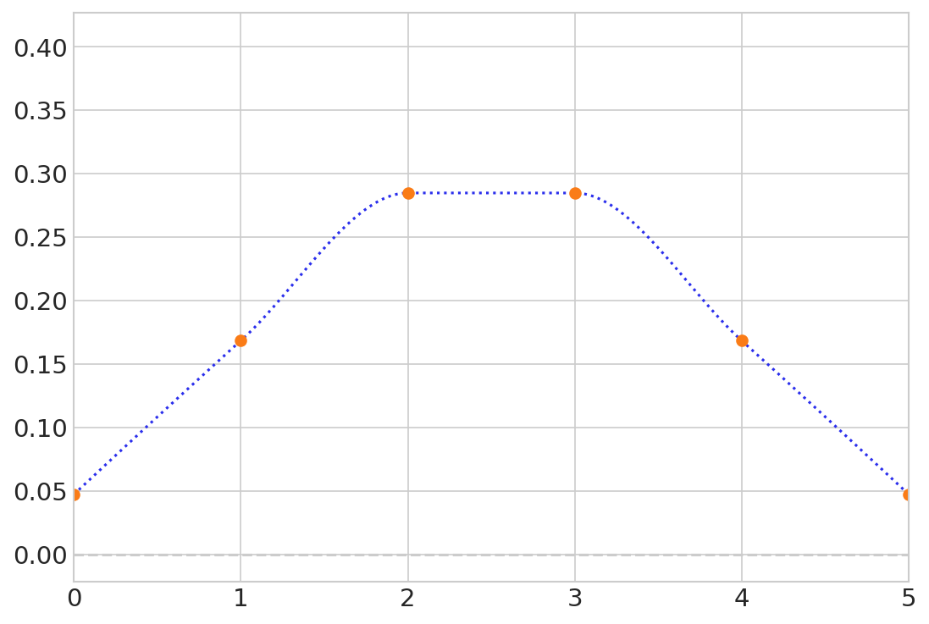

Exploring a distribution
Preliz software package has interactive plots so you can see what parameters do
pz.BetaBinomial(alpha=10, beta=10, n=5).plot_interactive(pointinterval=False)

Slide 45

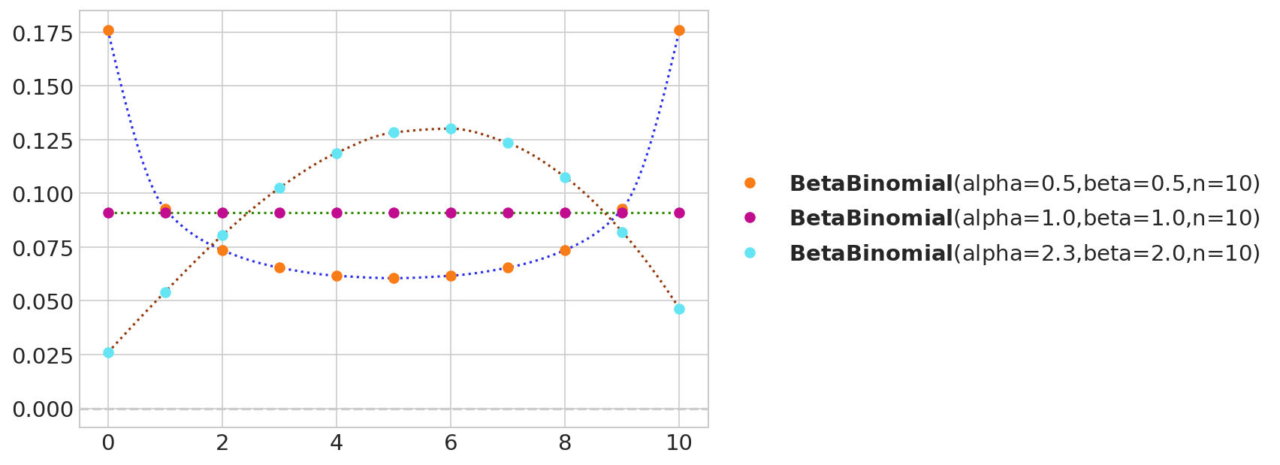
Parameterized probability distributions
The Beta Binomial distribution has 3 parameters

Slide 46
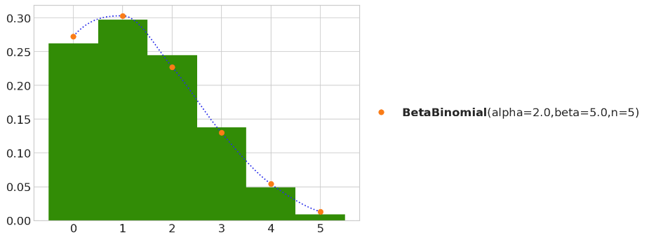
Generating samples from a distribution
plt.hist(pz.BetaBinomial(alpha=2, beta=5, n=5).rvs(1000),
bins=[0, 1, 2, 3, 4, 5, 6], density=True, align="left", color="C2")
pz.BetaBinomial(alpha=2, beta=5, n=5).plot_pdf();

Slide 47
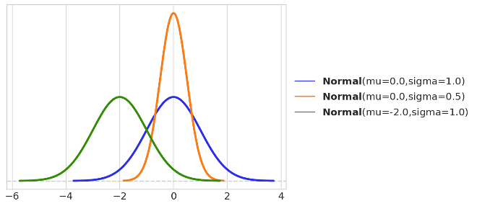

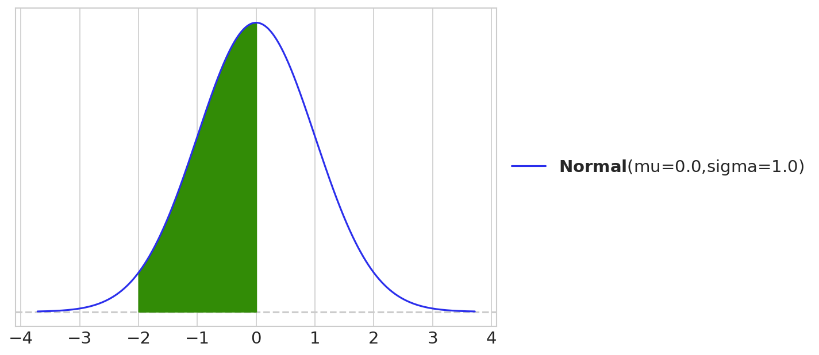

Continuous random variables

Slide 48
How to integrate a continuous variable
dist = pz.Normal(0, 1)
ax = dist.plot_pdf()
x_s = np.linspace(-2, 0)
ax.fill_between(x_s, dist.pdf(x_s), color="C2")
dist.cdf(0) - dist.cdf(-2)

Slide 49
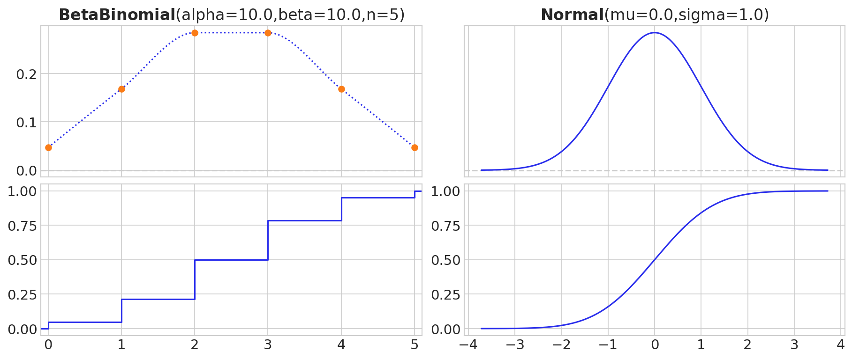
Cumulative distribution functions
Always go from 0 on the left to 1 on the right
Y axis is probability

Slide 50
1F Characterizing distributions

Slide 51
Describing the distribution with one number
We want to use a single number to describe the distribution
We can choose it
Where is the ‘middle’ of the data?

Slide 52
Describing the distribution with one number
Where is the ‘middle’ of the distribution?
Three common measures
  Median
  Mode
  Mean
There are others
  We use a different one to calculate your homework score

Slide 53
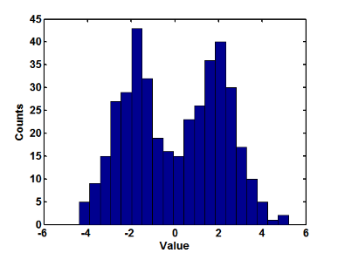
More than one mode
It is possible to have more than one mode
This often means that the distribution combines two different sources
Modes

Slide 54
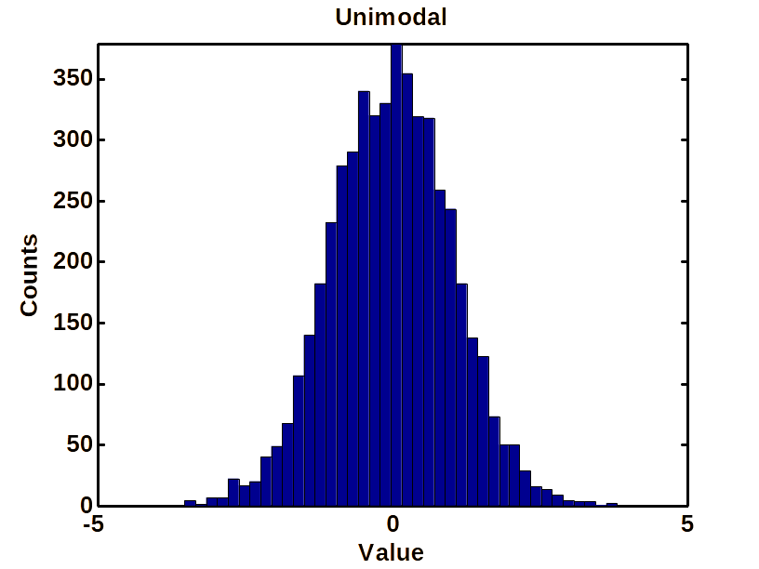
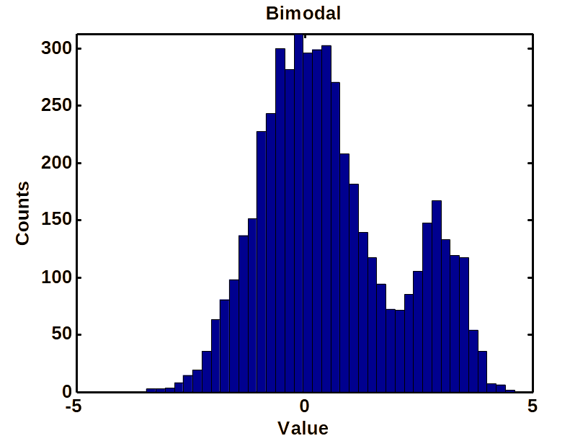
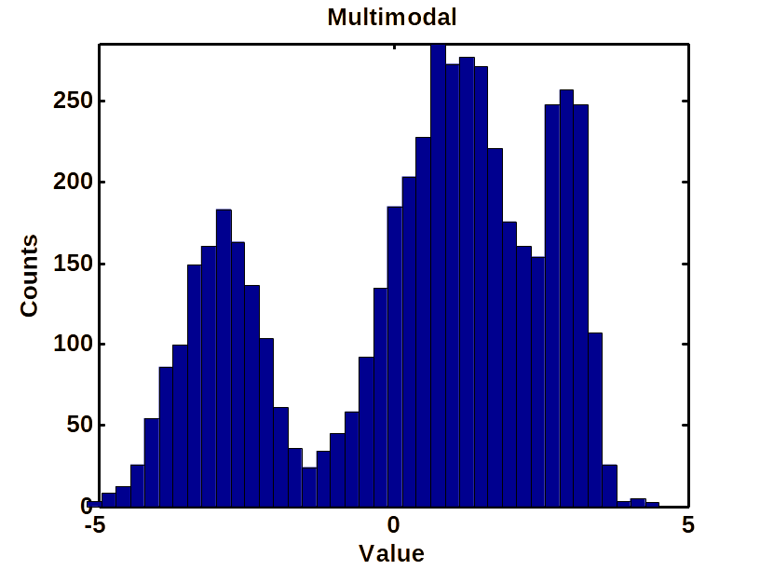
Unimodal and multimodal distributions
The mode is the point with the largest probability
We usually take multi-modal data to be selected from different unimodal distributions
So we will usually only deal with unimodal data

Slide 55
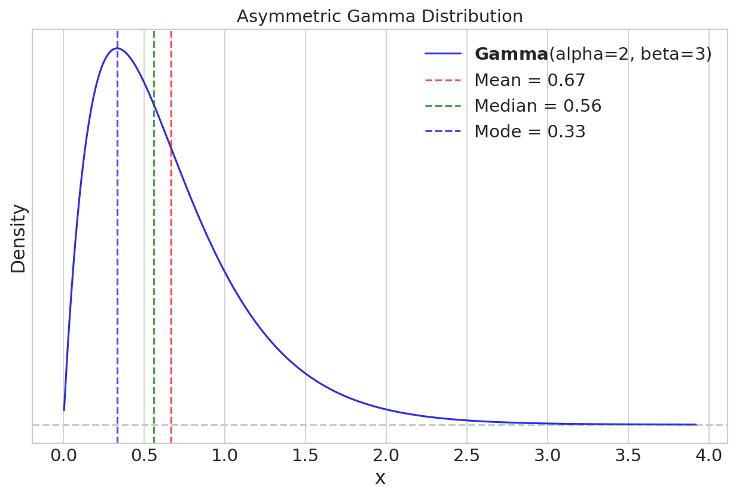
Measures of central tendency
Notice the difference between the mean, the median, and the mode
Which is better?

Slide 56
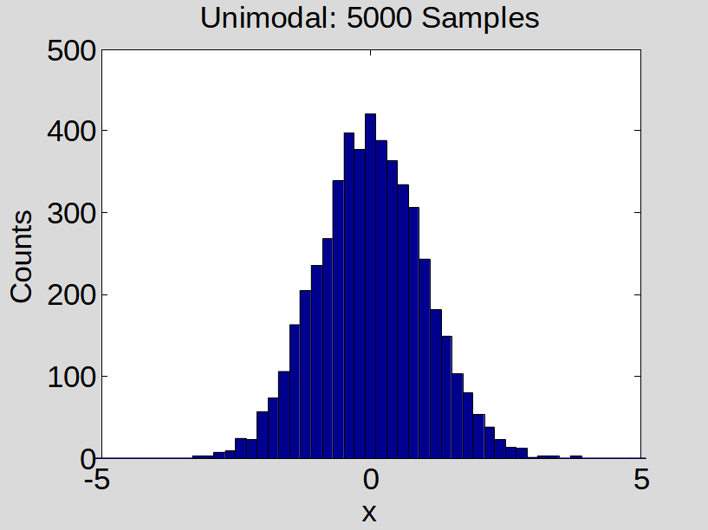
Representing a distribution with two numbers
The first number: where is the center?
The second number: how close to the center are we?
The dispersion
The center

Slide 57
Representing the distribution with two numbers
Center and spread
Again, we have different measures
  The standard deviation is the most commonly used
The variance:
The standard deviation:
The absolute deviation:
The inter-quartile interval: The difference between 0.75 and 0.25 of the distribution

Slide 58
Representing more details about the distribution
What should we use?
Skewness
  How symmetric is the data?
Kurtosis
  How sharp is the peak?

Slide 59
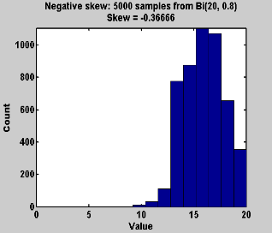
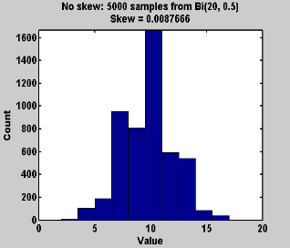
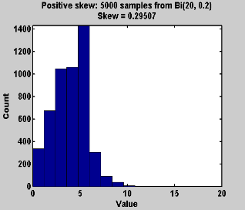
Measure of assymetry: Skewness
For the normal distribution, we only need mean and variance
For any other distribution, it will vary in either skewness or kurtosis
Skewness measures the symmetry of the distribution

Slide 60
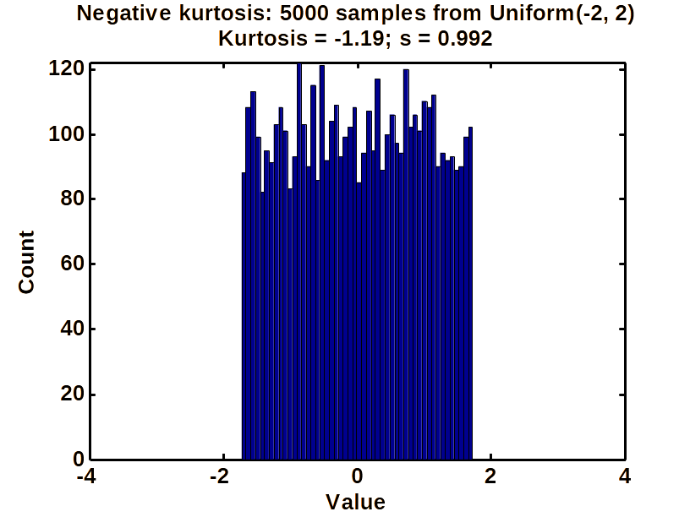
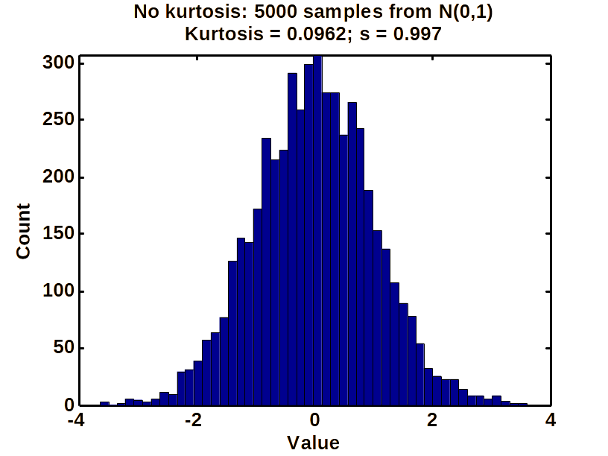
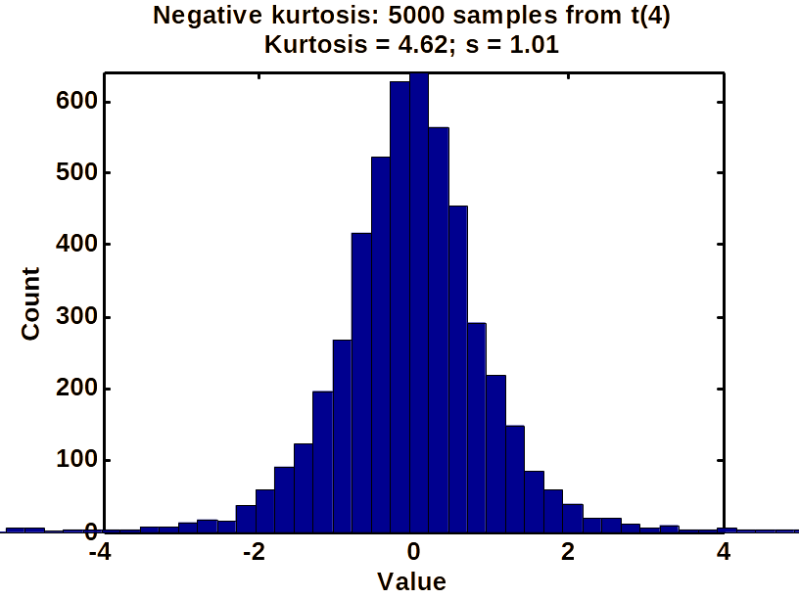
Sharpness of peak: Kurtosis
Kurtosis measures the size of the tails
This also captures the pointiness of the peak

Slide 61
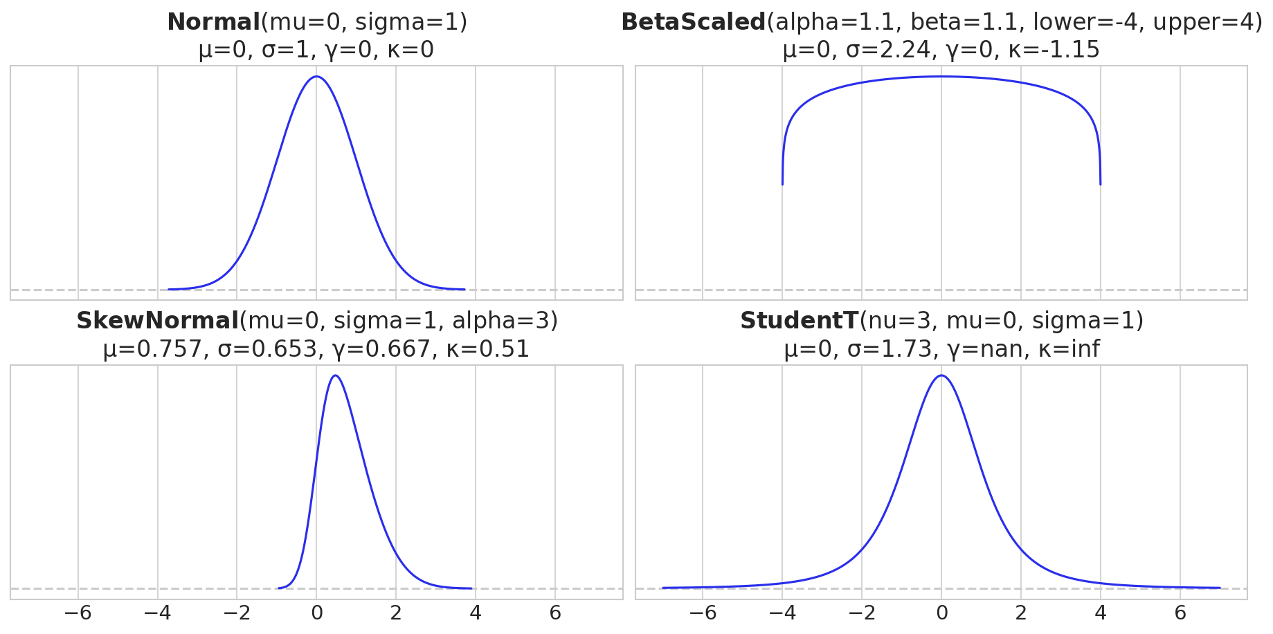
Mean, standard deviation, skewness and kurtosis of 4 distributions

Slide 62
1F Conditional probability

Slide 63
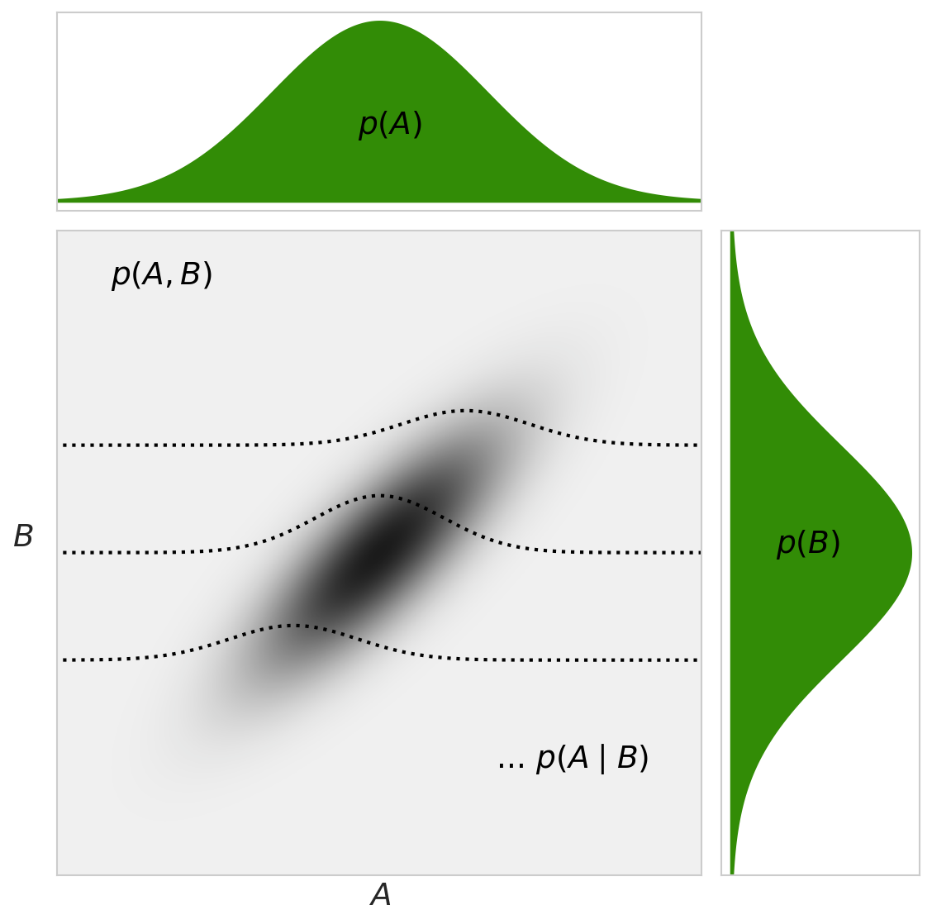

The joint distribution

Slide 64
Baye’s rule

Slide 65
Applied to data and models

Slide 66
We will use Baye’s rule to update our models

